Slide 1
Towards a fully-staffed, flexible workforce
D268 Task 3
William Jackson
Notes:
- Hello. Today I’m going to give a presentation on how the company could attain a fully-staffed, flexible workforce

Slide 2

Introduction
“98% of workers want to work remote at least some of the time…
57% of workers would look for a new job if their current company didn’t allow remote work” (Haan, 2023)
The problem: Improving office attendance without hurting recruitment and retention efforts
Solution addresses office attendance and recruitment
  Role-based model
  Hub & Spoke model
Implementation
  Review every role for remote fit
  Regional offices
  Relocation packages
(123rf.com, 2023)
Notes:
-I’d like to begin with some interesting responses from a Forbes survey among American employees this year (READ)
-The problem: Improving office attendance without hurting recruitment and retention efforts
- My suggested solution therefore addresses both the need for increased office attendance and our recruitment needs
Combined solution of a
-Role-based model –distinguish each role based on rank and function in order to determine if it’s fit for remote or require in-office presence
-hub-and-spoke model whereby the main office complemented by regional branch offices
To implement these models, I suggest three measures:
That every role in the company is reviewed for remote fit
That we establish relocation offices
- And finally, that we provide relocation packages for employees relocating in relation to work
IMAGE – puzzle taken from 123rf.com illustrates the missing pieces in among our staff in the form of vacant positions

Slide 3
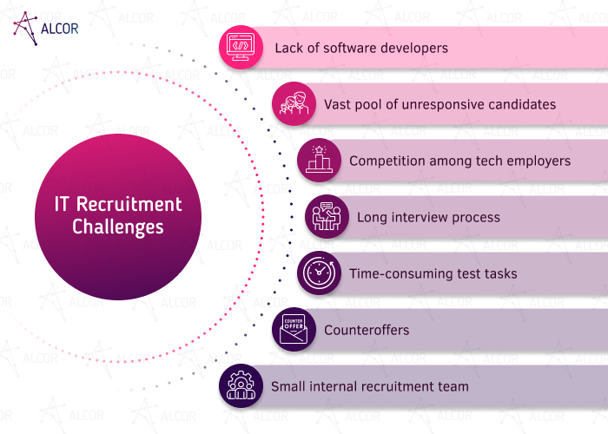
The Problems
Recruitment challenges
Retention challenges
Low levels of voluntary office attendance
(Panchuk, 2022)
Notes:
-We have three related problems that all will be addressed with my proposed solution
- We’ve long experienced problems with recruitment/retention before, during and after COVID (though easier since COVID-induced work-from-home policy)
-This is an Industry-wide challenge (not just our company) => IMAGE: Analysis by recruitment firm Alcor points to the recruitment challenges confronting the industry (top 3 particularly pertinent) READ
-Retention has been an challenge especially when the economy is doing well and competitors have poached our employees with enticing offers
- We currently have low levels of voluntary office attendance since a return to office has not been mandated, but the company has expressed higher office attendance as a Strategic priority.
Based on the surveys referenced in the introduction, a strict, across the board RTO policy would most likely exacerbate recruitment & retention challenges

Slide 4
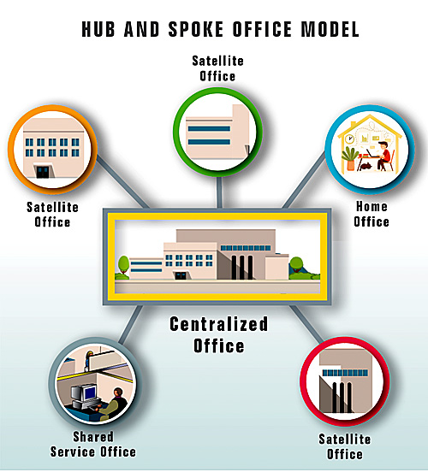
Proposal: Role model + hub-and-spoke model
Role-based model
  Physical attendance requirement based on
    Rank
    Function
Hub & Spoke model
  Regional offices in areas of many employees and clients
Effects
  Cost savings
  Recruitment advantage
  Adequate physical attendance
(Hickey & Douetil, 2021)
Notes:
My solution encompasses two models:
Role-based model based on rank and function
In terms of rank
Higher-ranked, executive roles could entail mandatory presence at the main office to in order to participate in strategic meetings and coordinate efforts.
These employees would also be the most motivated to move in order to preserve their advanced roles
-I also suggest differentiating based on function. Some functions are more collaborative than others. For example, employees involved in business strategy or system design could be asked to work from the main office permanently or at least when these whiteboard activities occur.
The Hub-and-spoke model entails
regional office in areas of high customer or employee concentration
IMAGE on the right taken from an article by Hickey & Douetil illustrates the Hub & Spoke model with Centralized Office complemented by satellite offices and some still working from home.
Now, the effects of my proposal include cost savings from downsizing headquarter space in the expensive Boston area (even accounting for marginal regional office footprint).
- Crucially, we can use this policy as a recruitment & retention advantage due to remote and regional hiring and employees in roles conducive to remote work could chose to remain remote and thus remain with the company
- It would also ensure adequate physical attendance in that we would have a full-on return to office for roles that are essential to the office

Slide 5
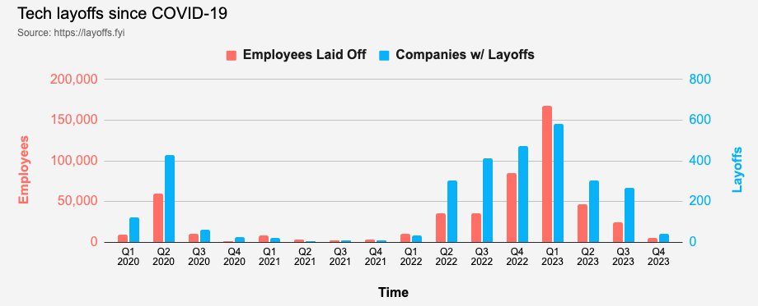
Implementation
  Review every role for remote fit
  Regional offices
    Employee concentration
    Client concentration
  Relocation package
  Aggressively recruit
(https://layoffs.fyi, 2023)
Notes:
To implement this proposal I suggest we:
Review every role for remote fit based on the rank and function (if high rank or collaborative, then require office attendance)
Identify where to establish regional offices
many employees in the Philadelphia and Phoenix areas could justify a leased office space there
In addition, we have many current and potential clients in the San Francisco Bay area and Chicago, so a sales office with additional work desks could be established there
And for those who are requested and agree to relocate in order to commute to an office, I suggest a relocation package to so that they do not shoulder needless personal costs from adhering to company policy. (Depending on available funds, this policy could be expanded to include those who voluntarily agree to relocate even when their roles are deemed fit for remote work.)
Once this policy is announced – we could aggressively recruit in the coming months for all roles (remote, regional, Boston-based)
We have a historical of opportunity to recruit currently due to the large number of layoffs during the last year-and-a-half
The graph you see here from layoffs.fyi illustrates how over 400.000 tech employees have been laid off in 2022 and 2023 combined. These are experienced employees who could meet our staffing needs.

Slide 6

Conclusion – a unique opportunity
Problems
  Recruitment
  Retention
  Low voluntary office attendance
Solutions
  Role-based model
  Hub-and-spoke model
  Seize the present moment of recruiting available tech talent
(stock.adobe.com, 2023a)
Notes:
- To conclude,
-To address the our challenges with recruitment, retention and low office attendance, we can apply the combined role-based model and the hub-and-spoke model as suggested
-I believe that we can brand this new policy and use it to seize the opportunity that the historical available tech labor pool has provided
-In this way, we can finally fill out all missing pieces of our employee puzzle and thus realize the full potential of this company (illustrated by the completed puzzle image from stock.adobe.com)
-I thank you for your attention!

Slide 7
References
123rf.com (2023). https://www.123rf.com/photo_47545853_puzzle-game-and-missing-pieces-on-blue- background.html
Stock.adobe.com (2023) https://stock.adobe.com/pe/images/puzzles-grid-blank-template-jigsaw-puzzle-with-60-pieces-mosaic- background-for-thinking-game-is-10x6-size-game-with-details-vector-illustration/277250910
Haan, Kathy (2023, June 12). Remote Work Statistics And Trends In 2023. Forbes. https://www.forbes.com/advisor/business/remote-work-statistics/.
Hickey, David & Guy Douetil (2021). Adapting to Agility: Leveraging a “Hub and Spoke” Model. https://www.areadevelopment.com/workplace-trends/workforce-q4-2021/adapting-to-agility-leveraging- hub-spoke-model.shtml
Panchuk, Marina (2022, November 22). 7 Common IT Recruitment Challenges and How to Solve Them. Alcor.
    https://alcor-bpo.com/recruitment-news/7-common-it-recruitment-challenges-and-how-to-solve-them
Tech Layoffs in 2022-2023 (2023, October 21). https://layoffs.fyi/

